Slide 1
Sentiment Classification Using Natural Language Processing and Different Machine Learning Techniques
Presented by- Shovan Chowdhury (MS student, ISU)

Slide 2
Why Sentiment Analysis?
Movie Review: Is this review positive or negative?
Products: What do you think about the new iPhone 11?
Politics: What do people think about this candidate or issue?
Prediction: Predict election outcomes or market trends from sentiment

Slide 3
Different Segment of Project
Project is divided into four steps.
Read Data
Pre-processing of data using NLTK
Test-train with machine learning
Comparing results of different algorithm

Slide 4
Read Data
Read separately positive and negative data
Create function to add label separately
Combine both data to create one report

Slide 5
Pre-Processing of Data
Flow chart of natural language processing:
Break Text into sentences and words
Tokenization
Break Text into sentences and words. It create a list of word.
Clean Text
Remove any punctuation mark and converting every every word to lower case alphabet
Remove Stopwords
Stopwords are that word which will not have any significance in classification like ‘am’, ‘for’ etc.
Stemming
Stemming is process of reducing infected or derived word to their word of base root form. For example: ‘go’ is the base root of ‘go’, ‘went’, ‘gone’, ‘going’ etc.

Slide 6
Pre-Processing of Data
After completing natural language processing, The data stored in a list of array like that-

Slide 7
Vectorization of Data
Two types of vectorizer:
Break Text into sentences and words
Count Vectorizer
Count all of the words. All the word has same importance. No semantic information is preserved.
TF-IDF Vectorizer
Some semantic information is preserved as uncommon words are given more importance than common words.
For Example: ‘The movie is excellent’. Here ‘excellent’ will have more importance than ‘The’ or ‘movie’.

Slide 8
Applying Different Classification technique
Four machine learning classification technique Used.
Support Vector Machine
Naive Bayes
K-nearest Neighbor
Decision Tree

Slide 9
Comparison of Result
Algorithm | Parameter used | Train Accuracy | Test accuracy | F1 Score(for test data)
SVM | Kernel= linear, C=1.0 | 0.92 | 0.75 | 0.75
Naïve Bayes | Multinomial NB | 0.91 | 0.77 | 0.77
K-Nearest Neighbor | N_neighbors=15 | 0.77 | 0.71 | 0.71
Decision Tree | Max depth = 110 | 0.90 | 0.61 | 0.61

Slide 10
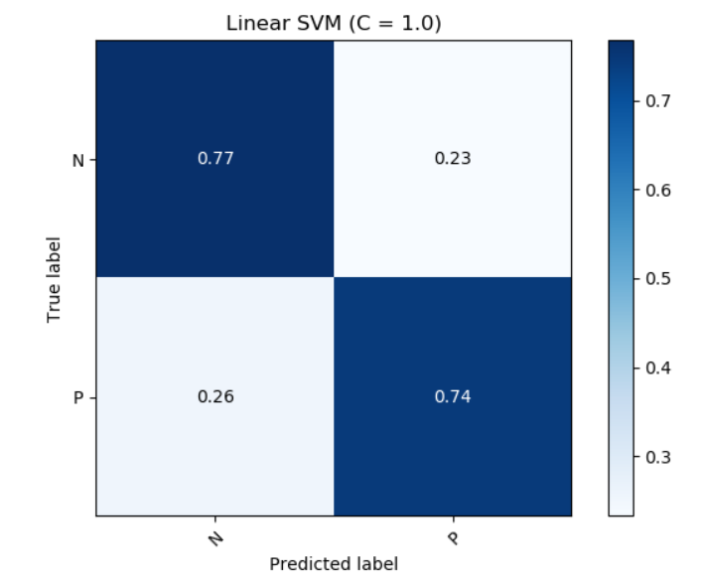
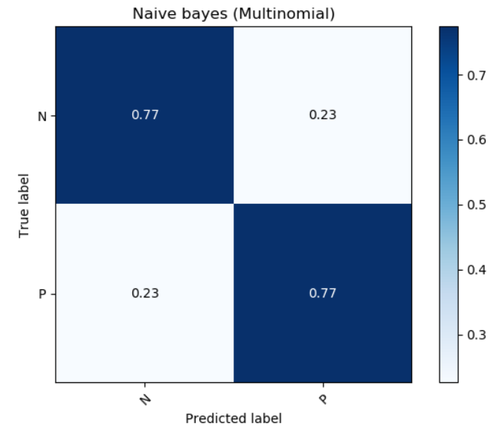
Confusion Matrix
SVM
Naïve Bayes

Slide 11
Future Improvement
More pre-processing in NLP portion
Using dependency Parser (analyzes grammatical structure of text)
Word Embedding (word2vec, glove, doc2vec)

Slide 12
Thank you!

